Slide 1
Chemistry in Life
Chemistry is Useful. But be careful.
HW: Find out the related chemical reaction equations.

Slide 2
Aluminum
A very useful metal
HW:
Advantages:
Disadvantages:

Slide 3
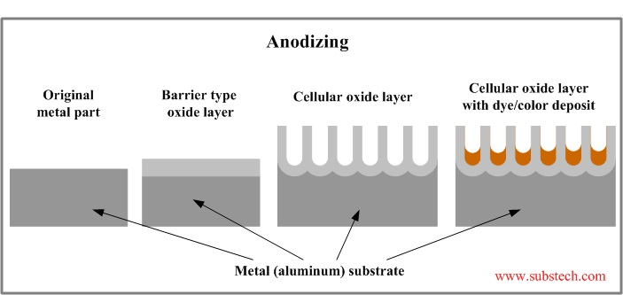

Slide 4
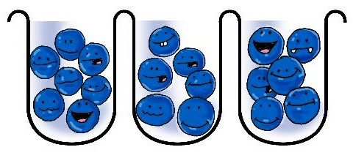
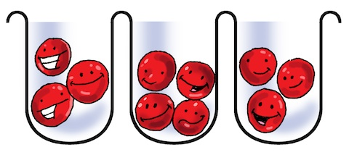
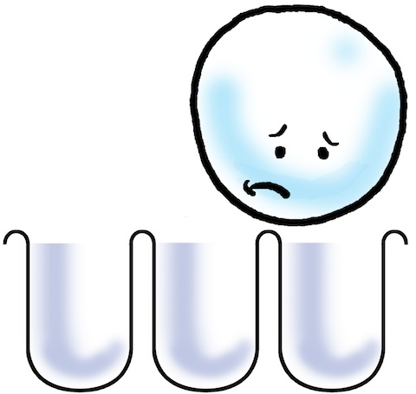
Why is there no white anodized aluminum?
http://www.bluebuddhaboutique.com/blog/2011/09/no-white-anodized-aluminum/

Slide 6
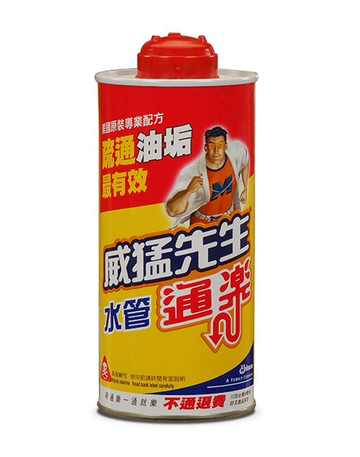
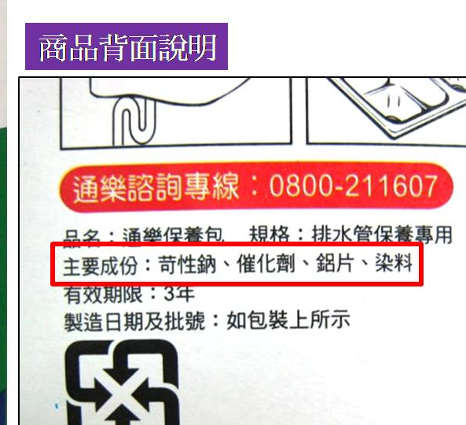
chemical drain cleaner

Slide 7
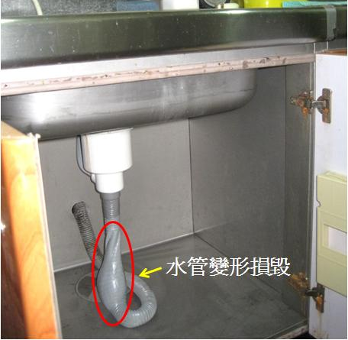
https://www.igreen88.com/2012/06/part-2.html

Slide 9
Bleach + hydrochloric Acid. No!
Cl₂ + H₂O ⇌ HClO + Cl⁻ + H⁺

Slide 10
Sodium hypochlorite is the most commonly encountered bleaching agent, usually as a dilute (3–6%) solution in water. … It is produced by passing chlorine gas through a dilute sodium hydroxide solution
Cl2 (g) + 2 NaOH (aq) → NaCl (aq) + NaClO (aq) + H2O (l)
or by electrolysis of brine (sodium chloride in water).
2 Cl− → Cl2 + 2 e−
Cl2 + H2O ⇌ HClO + Cl− + H+
The dilute solution of sodium hypochlorite is used in many households to whiten laundry, disinfect hard surfaces in kitchens and bathrooms, treat water for drinking and keep swimming pools free of infectious agents.
Wiki: bleach

Slide 11
中華電視公司
發佈日期：2011年10月18日
高雄縣茄萣國中，中午有三名國中生聞到刺激氣體不舒服，學校緊急送醫，還好醒來後平安。不過到底聞到什麼東西，事後學生才坦承，本來要去掃廁所，結果一時覺得好奇心，就把鹽酸加上漂白水，產生了刺鼻的氯氣會傷害呼吸黏膜，才會聞到昏倒。

Slide 12
老師說，原來是上午下課時間，這三個男同學曾經聽同學說，鹽酸加漂白水可以有強力清潔效果，只是臭了點，三個人好奇就想說那我們也來試試看，結果這充滿實驗精神的一試，卻讓三個男同學被嗆到送醫。

Slide 14
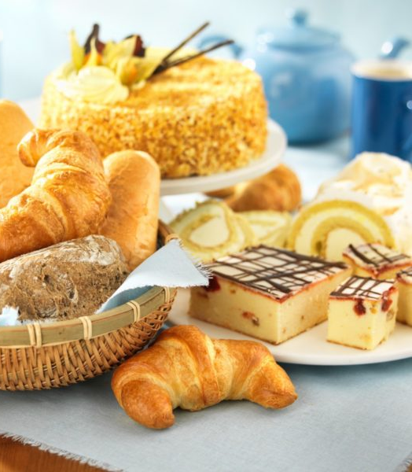
NaHCO₃
Baking soda, Sodium bicarbonate
小蘇打
Food additive, Cleaning agent, …
H₂CO_{3(aq)} ⇌ H₂O + CO_{2(aq)}
It reacts with acidic components in batters, releasing CO₂, which causes expansion of the batter and forms the characteristic texture and grain in pancakes, cakes, quick breads, soda bread, and other baked and fried foods.
Wiki

Slide 15
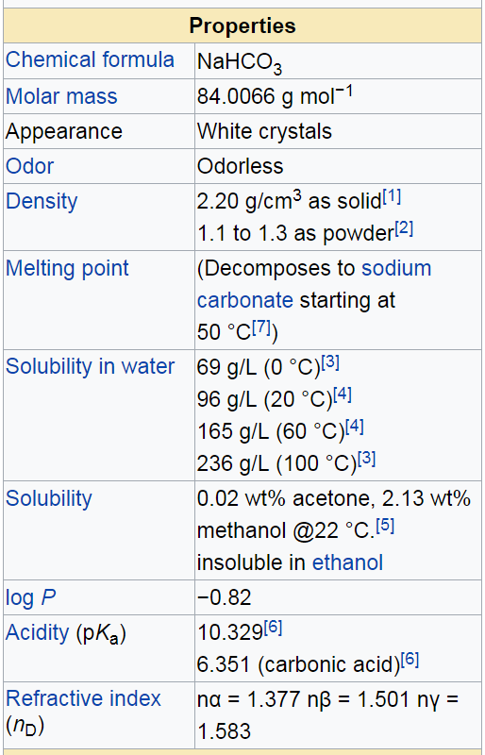
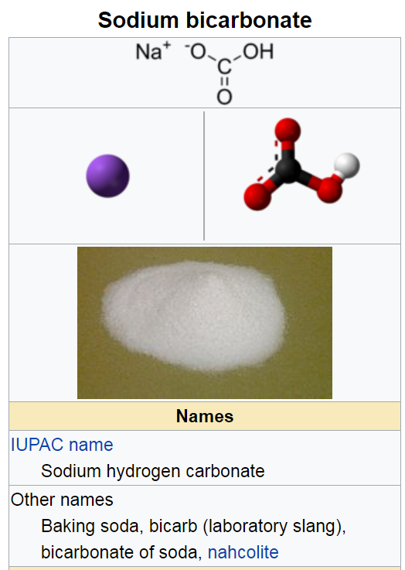
Wiki

Slide 16
All species are in aqueous solution.
H₂CO₃ ⇌ H⁺ + HCO₃⁻ K₁ = 4.46x10⁻⁷ (M)
HCO₃ ⁻ ⇌ H⁺ + CO₃²⁻ K₂ = 4.69x10⁻¹¹ (M)

Slide 17
K₂ = 4.69x10⁻¹¹ (M)
H⁺ + CO₃²⁻ ⇌ HCO₃⁻ + H₂O ⇌ OH⁻ + H₂CO₃
+ H₂O
K_{b} = 2.24x10⁻⁸ (M) K_{w} = [H⁺][OH⁻]=1x10⁻¹⁴ (M²)
HCO₃⁻ acts as both Acid and Base
K_{b} > K₂, slightly basic, stabilize pH

Slide 18
Equilibrium concentrations at all pH values

Slide 20
How to solve “arbitrary pH” case.
Let pH = any value, eg 8.0
Solve for x and y.
Set another pH value, eg 7.9, repeat.
Then you would obtain the two above figures.

Slide 22
How to solve NaHCO_{3(s)} + H₂O case (no extra acid or base added):
1. Find dominate species from above figure,
2. Use charge & mass balance
Major
minor
minor

Slide 23
2. Use charge & mass balance
Major
minor
minor

Slide 25
Sodium bicarbonate Properties
Melting point:>300 °C(lit.)
Boiling point:851°C
Density 2.16 g/mL at 25 °C(lit.)
refractive index 1.500
storage temp. 2-8°C
solubility H2O: 1 M at 20 °C, clear, colorless
PH8.3 (0.1 molar freshly prepared)
pka(1) 6.37, (2) 10.25 (carbonic (at 25℃)
Water Solubility 9 g/100 mL (20 ºC)
http://www.chemicalbook.com/ChemicalProductProperty_EN_CB7492884.htm
General Description
Odorless white crystalline powder or lumps. Slightly alkaline (bitter) taste. pH (of freshly prepared 0.1 molar aqueous solution): 8.3 at 77°F. pH (of saturated solution): 8-9. Non-toxic.

Slide 26
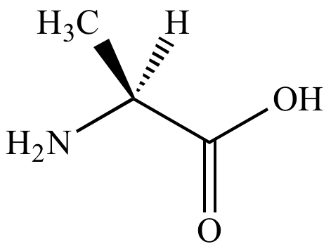
Glycine (甘胺酸)
H
An amino acid changes its charged state (+1, neutral, or −1) depending on the pH value. This property plays a very important role in biology and bioanalysis.
^{(HW-16b)} Plot the concentration profiles of the related species, [NH₃⁺−CH₂COOH], [NH₂−CH₂COOH], and [NH₂−CH₂COO⁻], for the system of 0.1 M glycine aqueous solution as a function of pH.

Slide 27
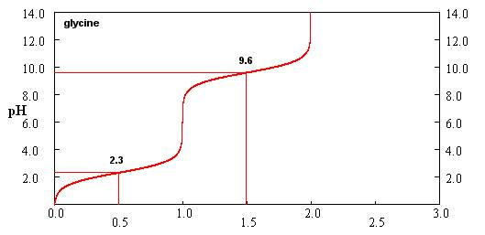
Appendix: Titration curve of glycine
Relative amount of NaOH added
https://www.chem.fsu.edu/chemlab/bch4053l/character/titration/

Slide 28
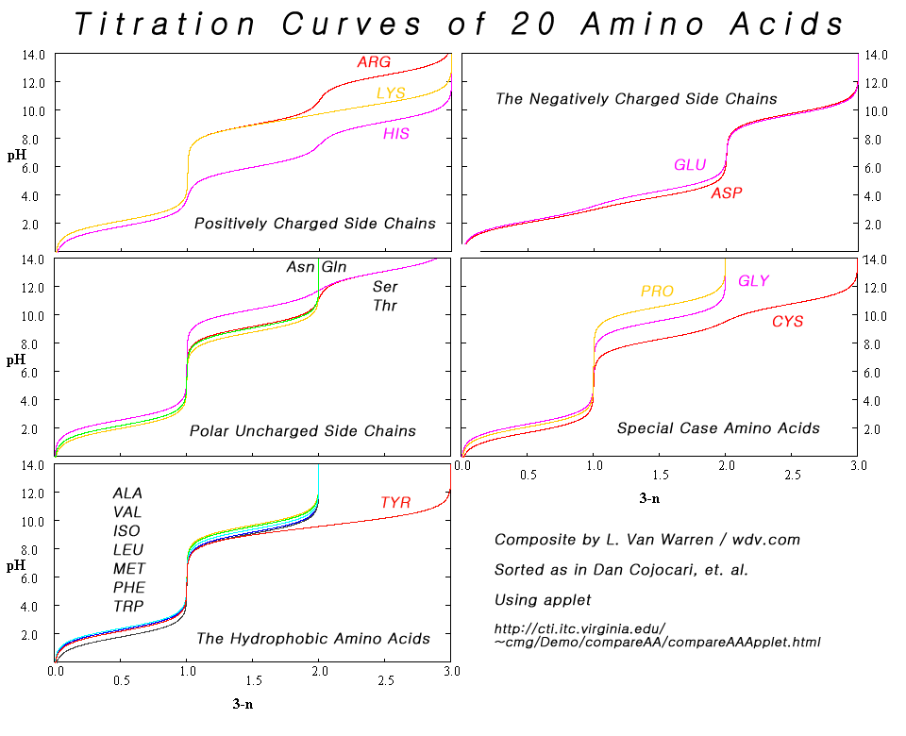
Appendix

Slide 30
Hand Warmer 暖暖包 oxygen buster
4Fe_{(s)}＋3O_{2(g)} → 2Fe₂O_{3(s)}
ΔH＝−826 kJ/mol
Most pure metals are quite reactive towards oxygen, except _________.
Why it is not often to see a metal burns?

Slide 31
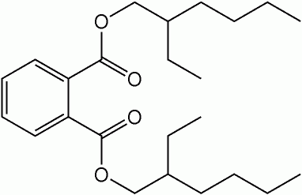
Plastic materials
PE, PP, PS, PVC, Teflon, and many more.
Plasticizers 塑化劑
Public Domain, https://commons.wikimedia.org/w/index.php?curid=388279

Slide 33
How to know a bottle of clear liquid is water or liquor without opening it?

